Slide 1


Slide 2
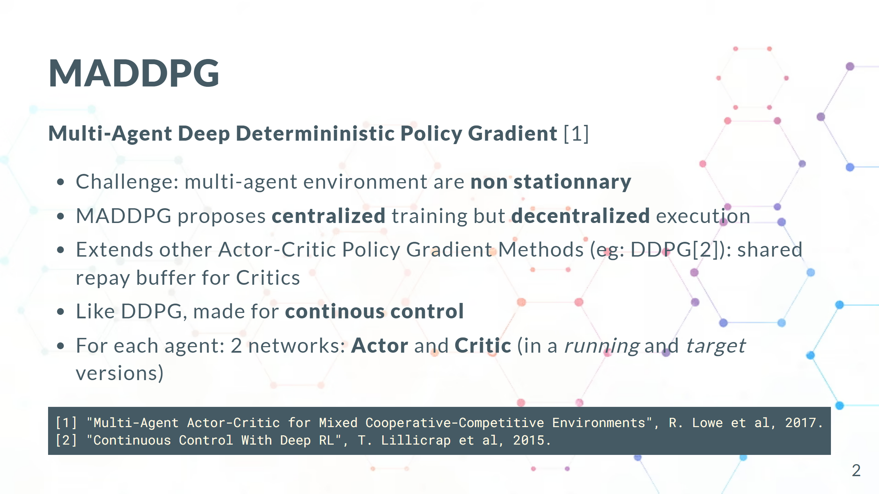

Slide 3
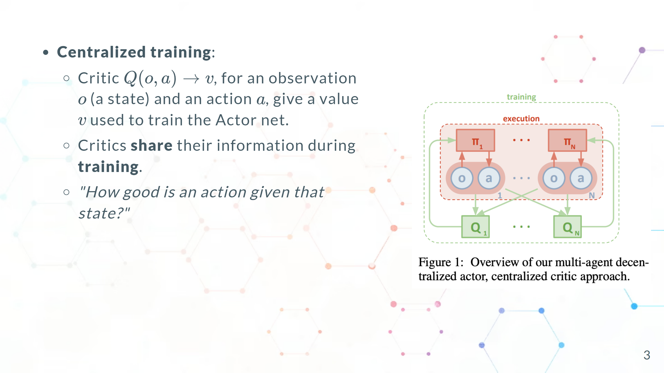

Slide 4
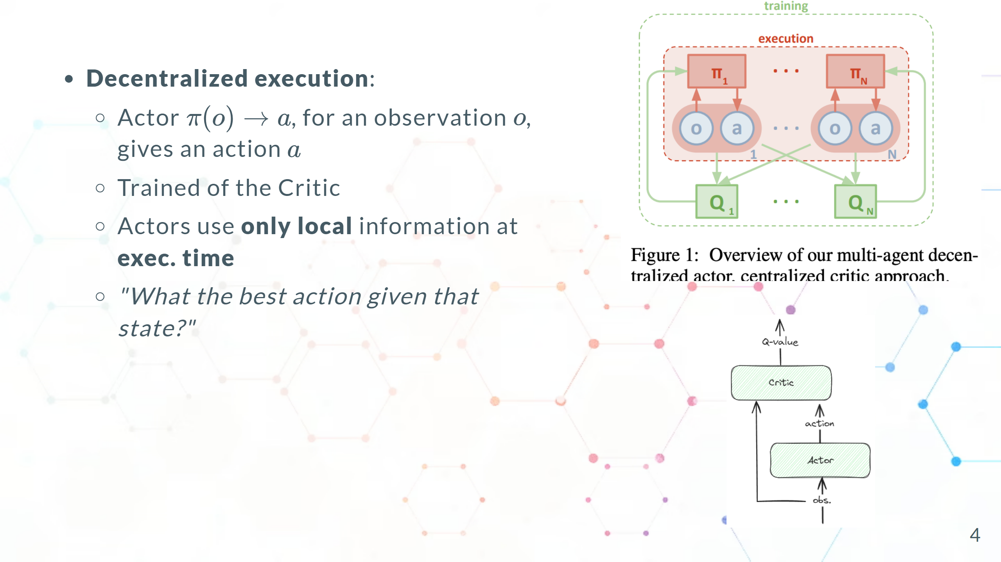
Notes:
# TODO: - non stationnary - Q-value - running vs target - p_loss vs q_loss

Slide 5
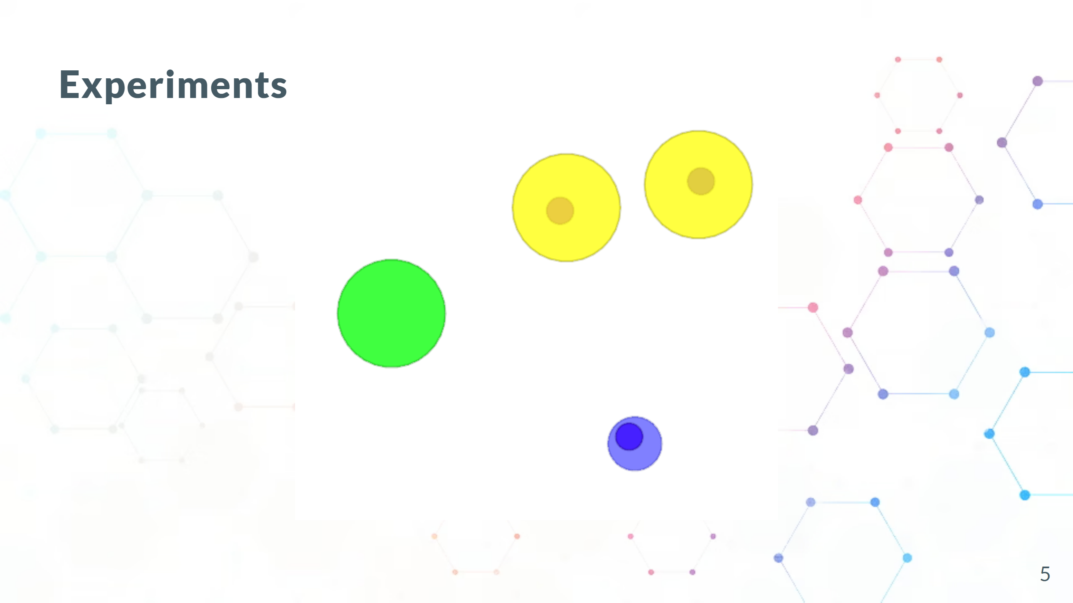
Notes:
- 1 Table - capture de metriques - Ex de code - What went well/wrong - CC/next steps

Slide 6
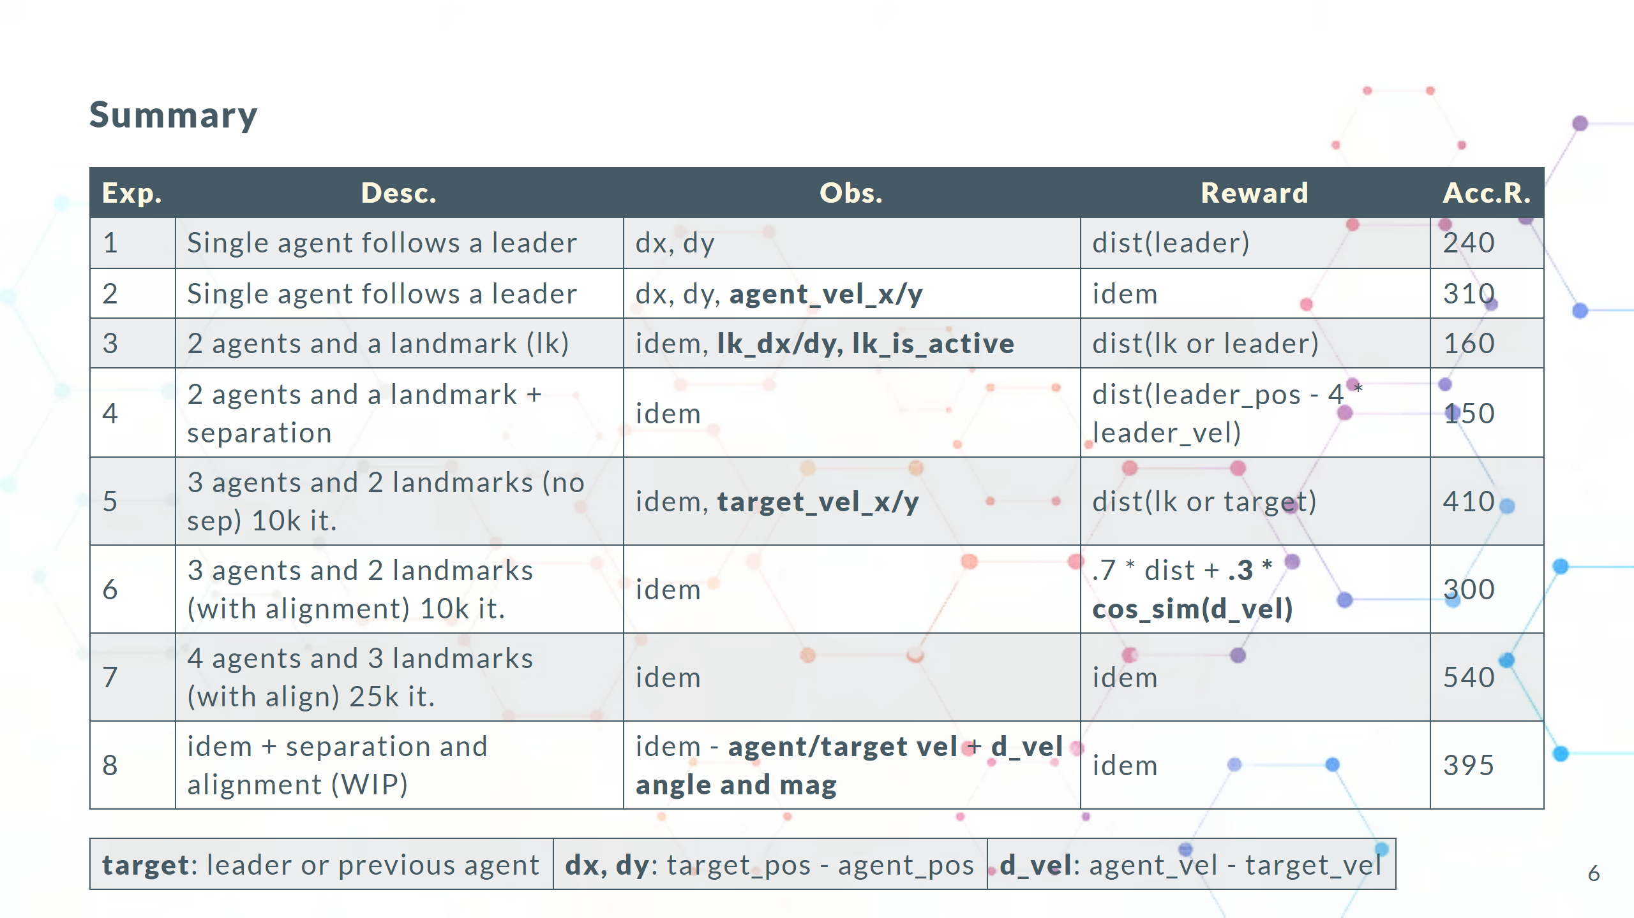
Notes:
Scoped style

Slide 7
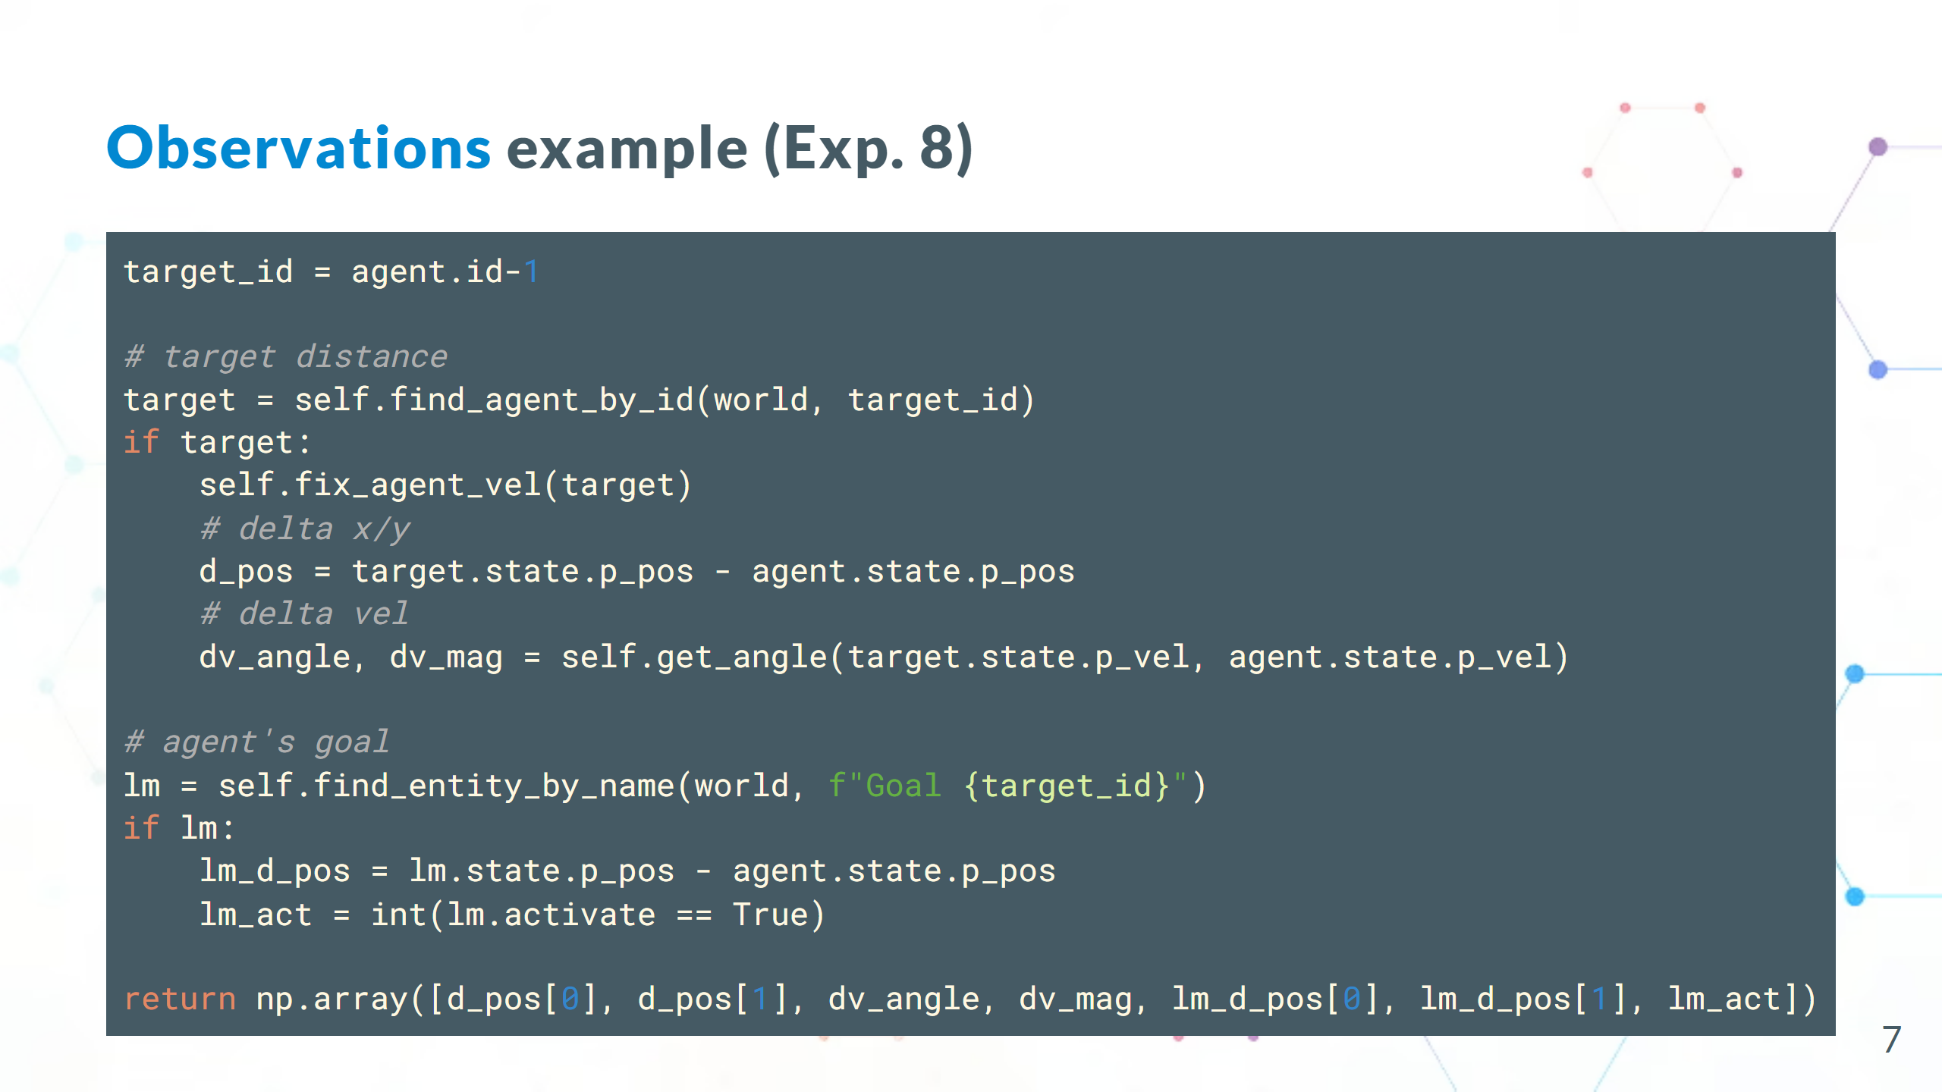

Slide 8
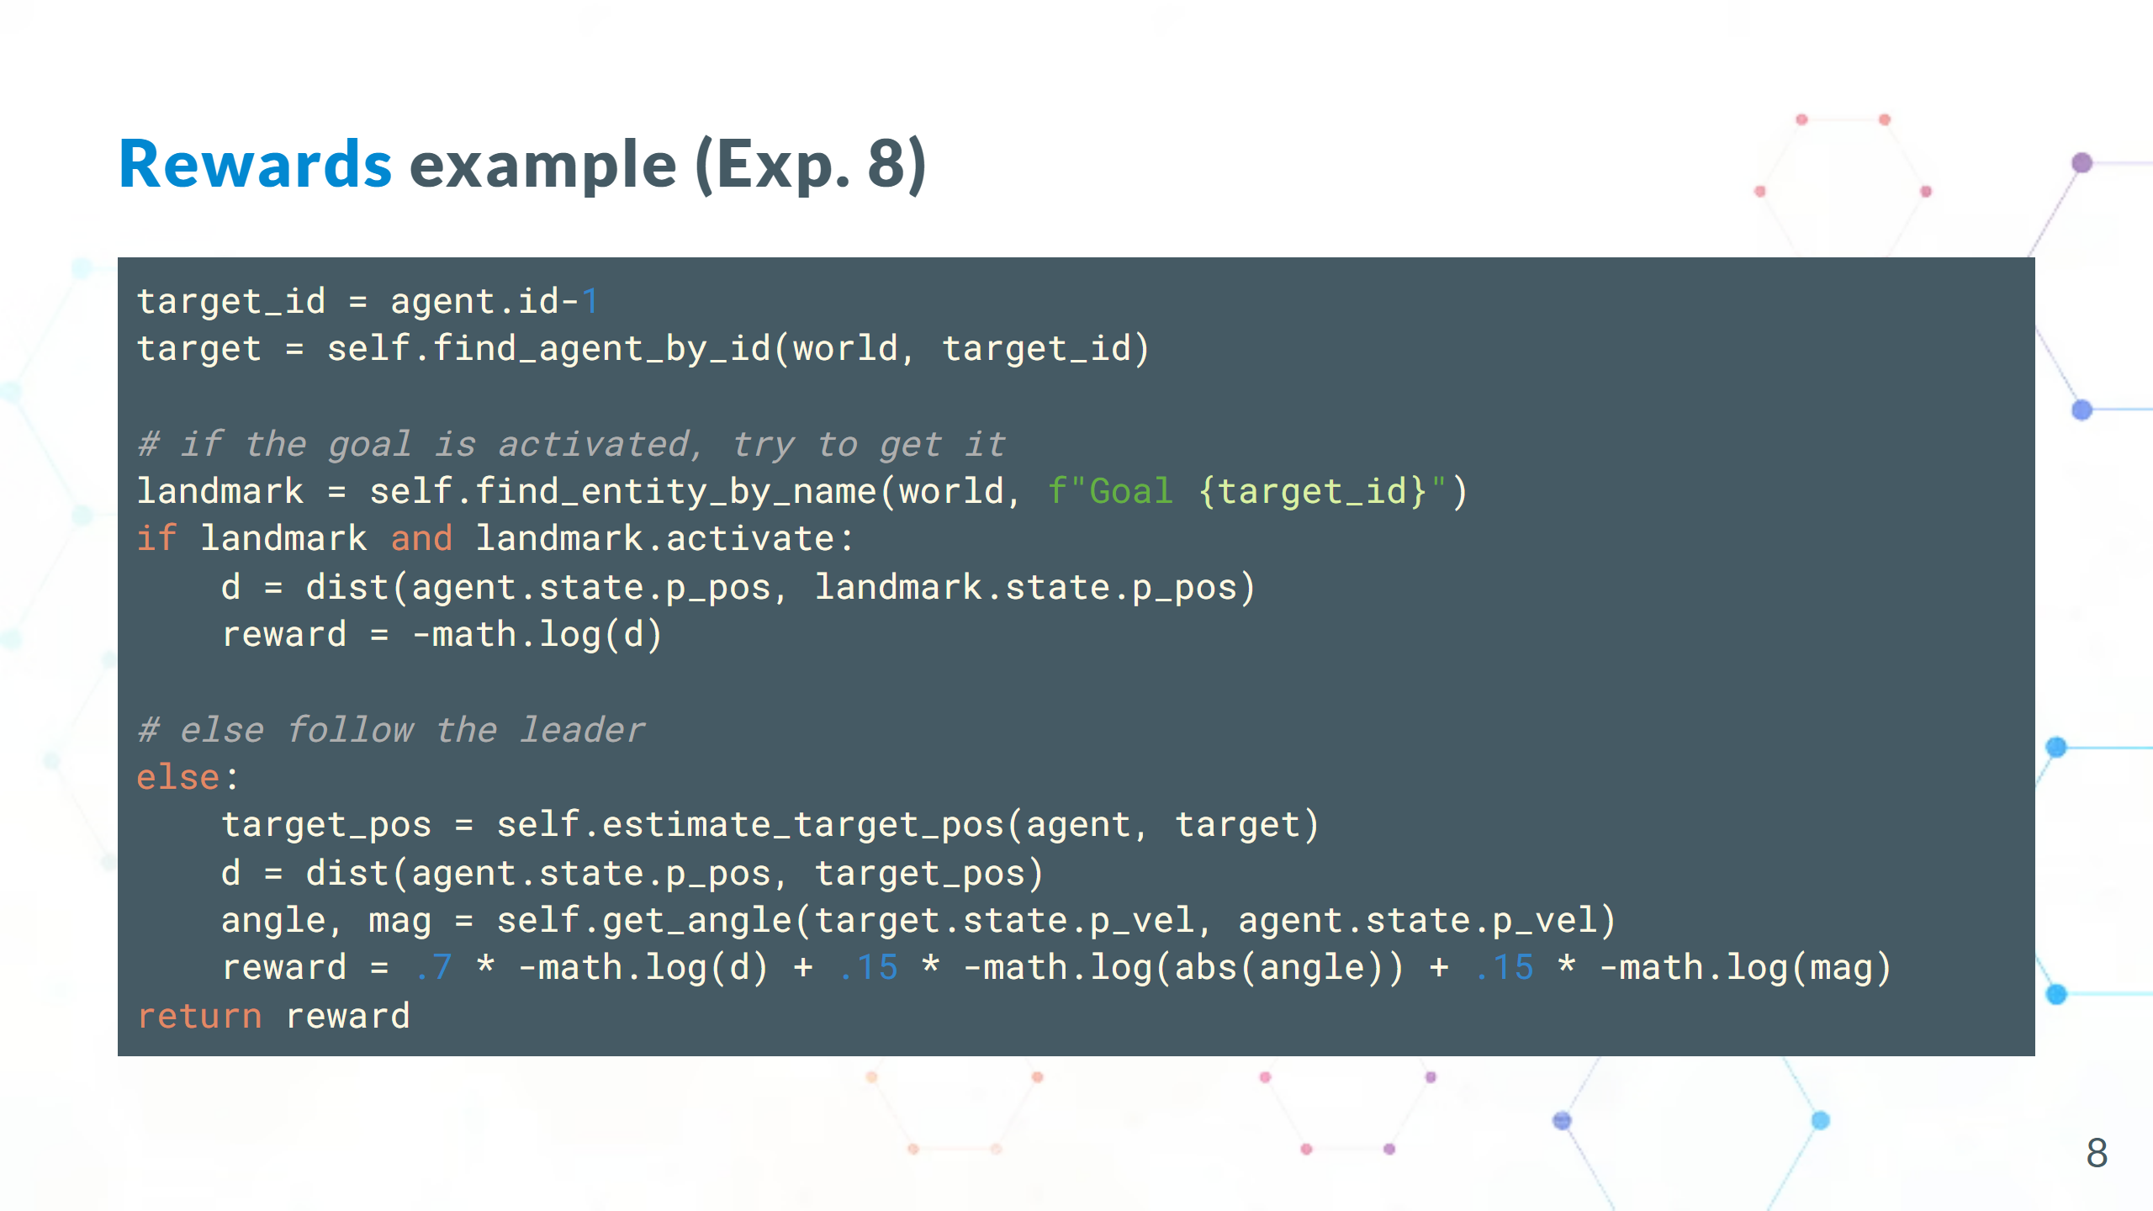

Slide 9
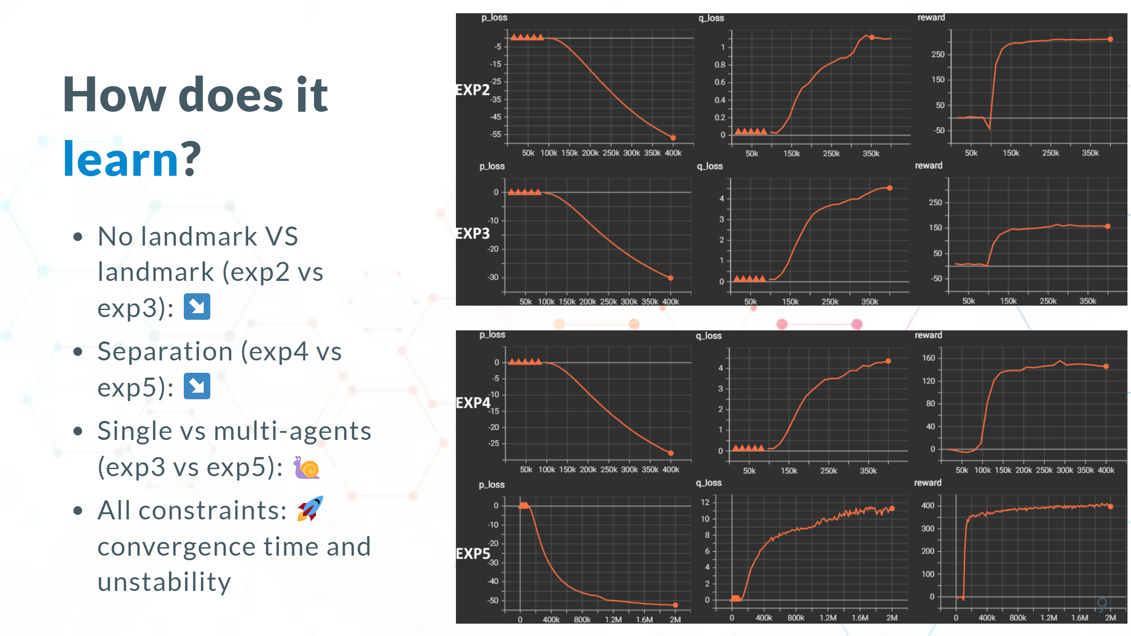

Slide 10
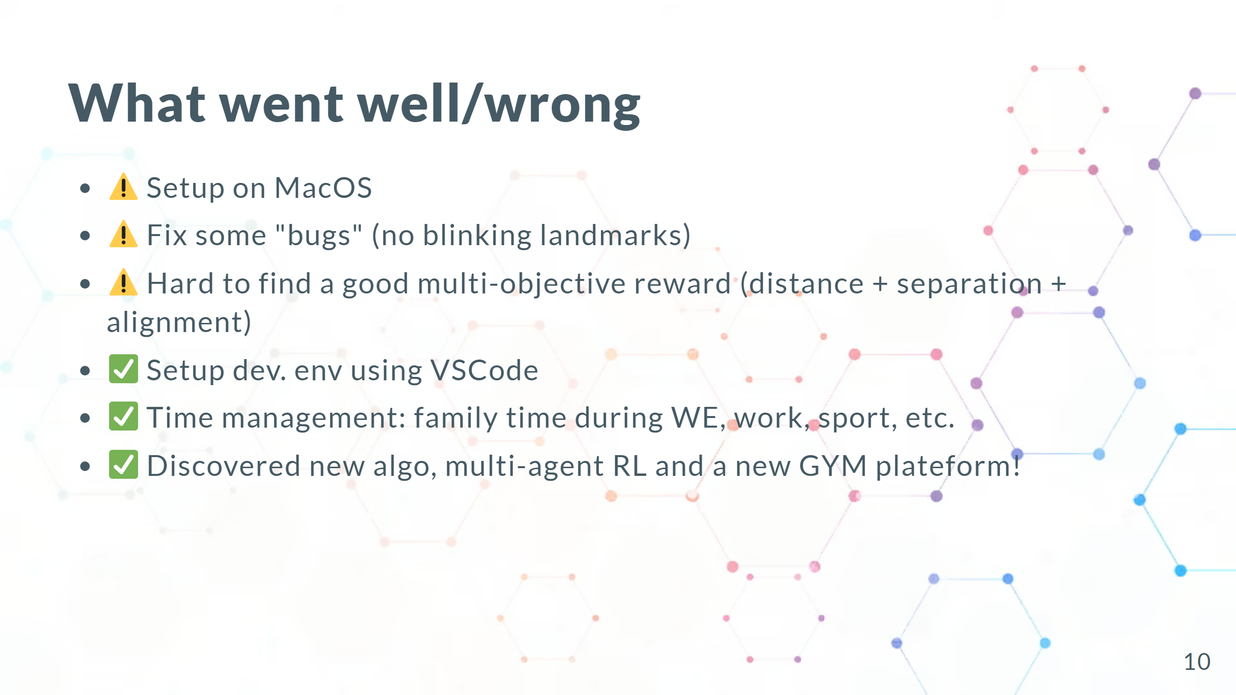

Slide 11
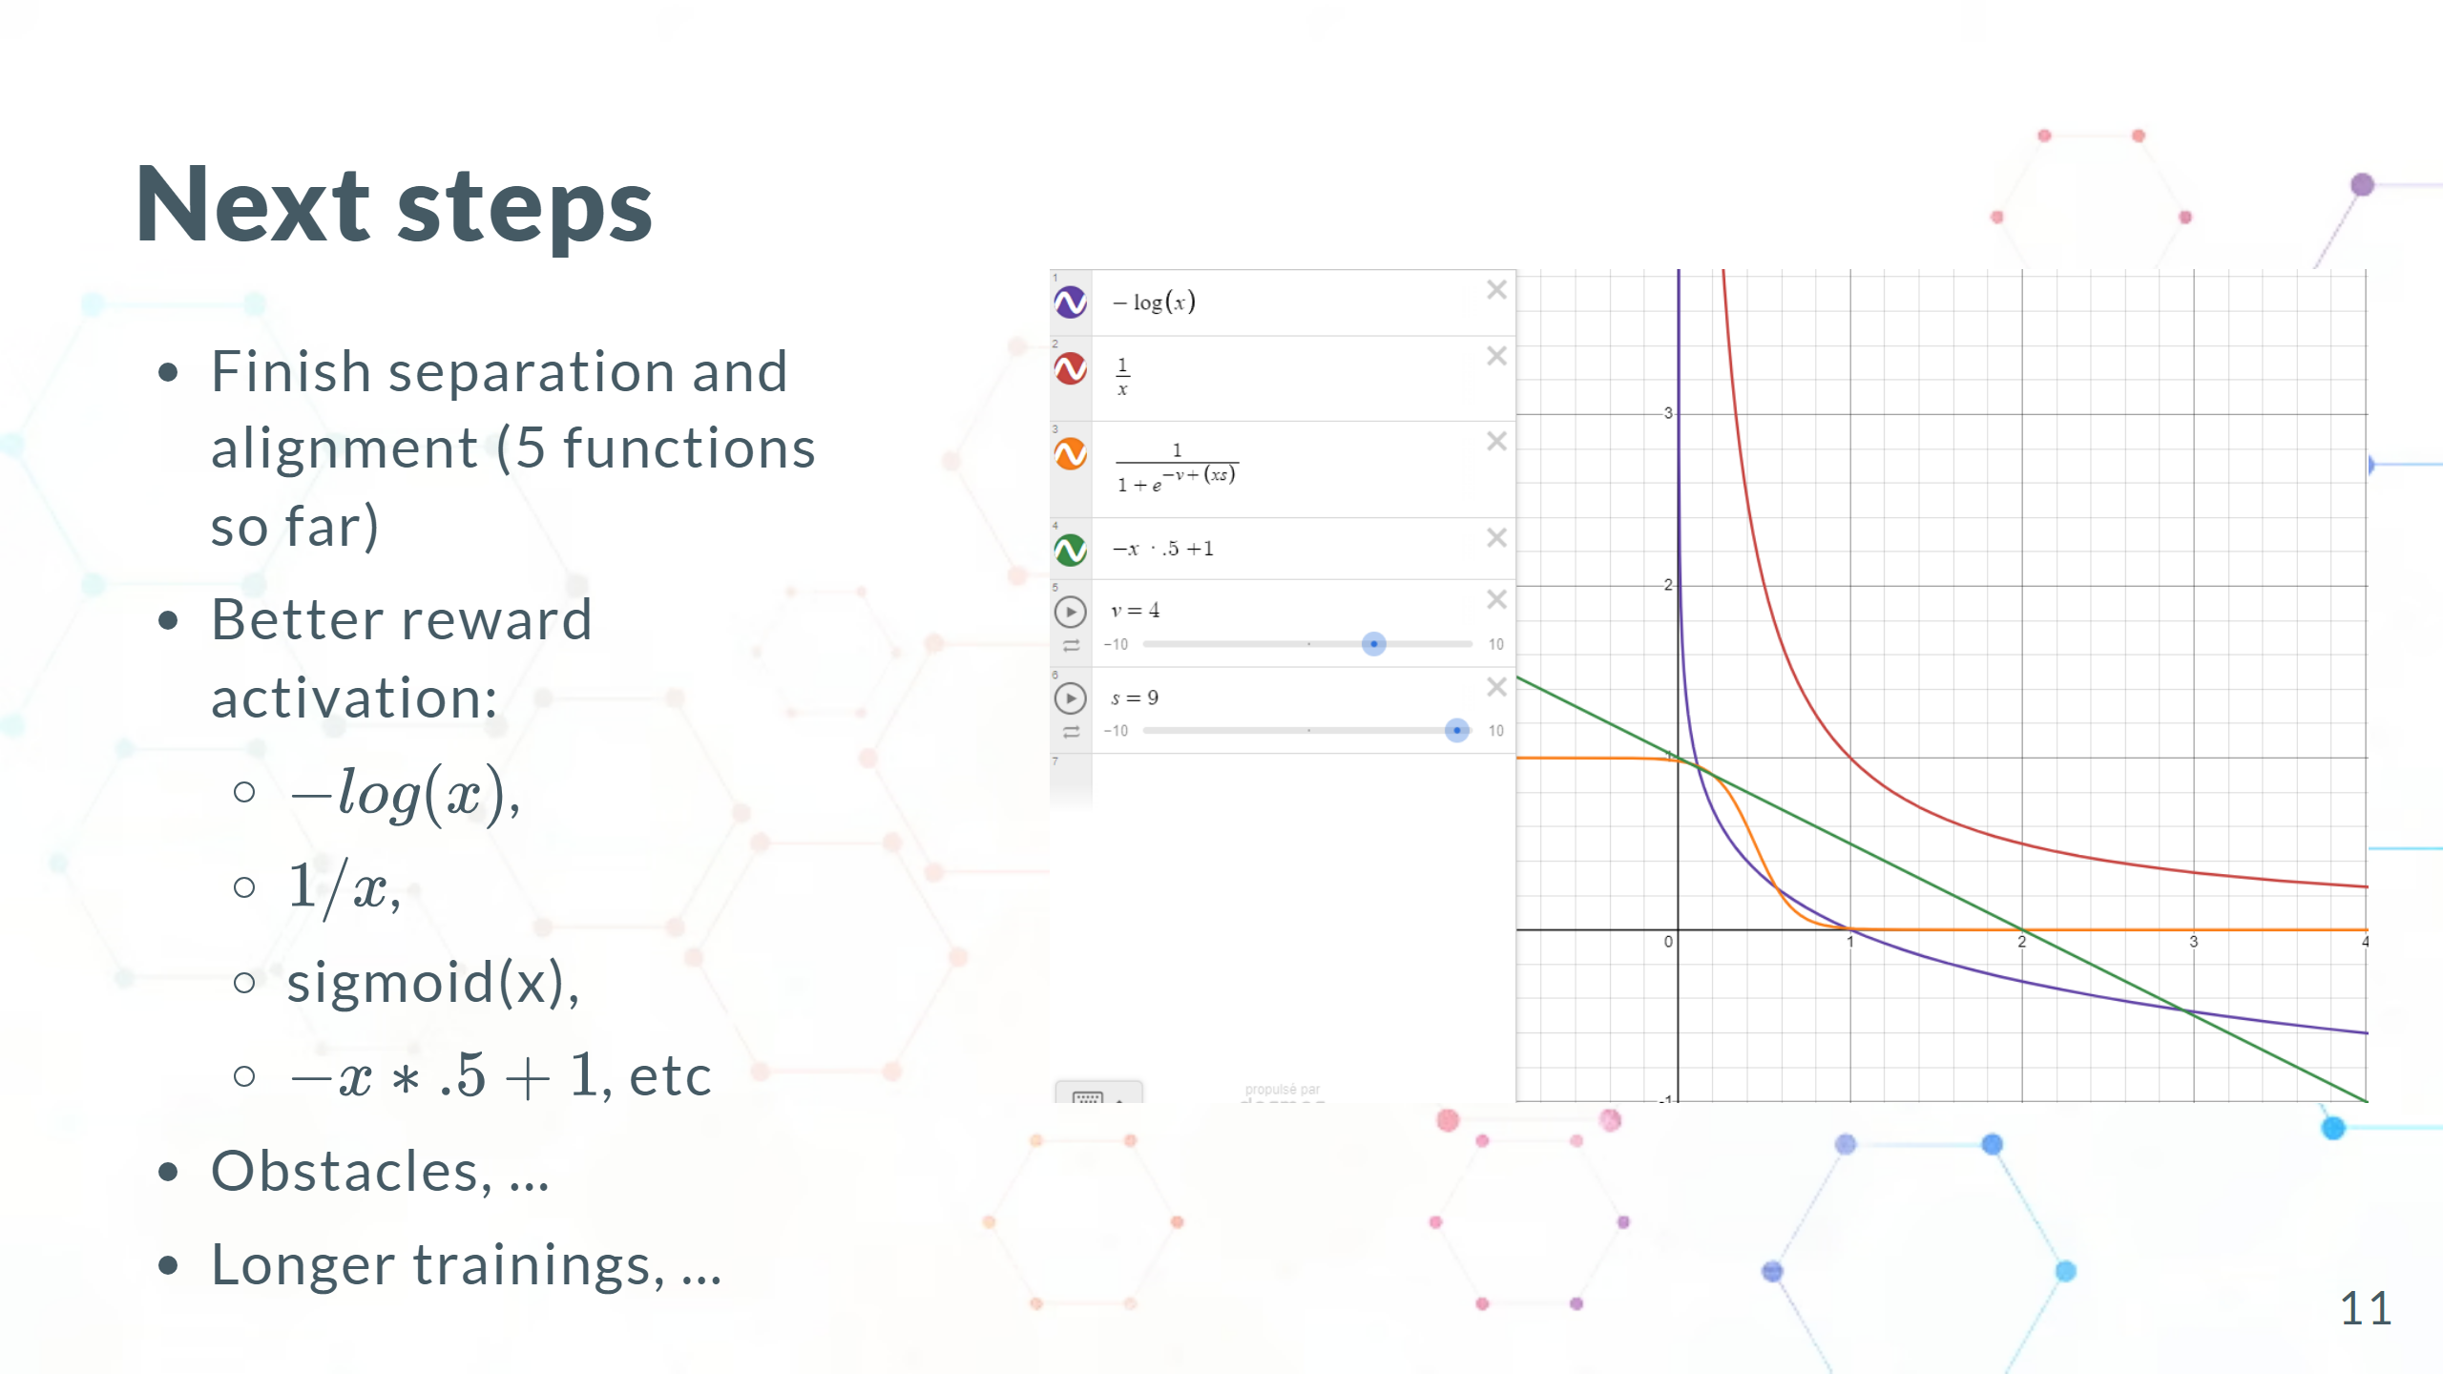

Slide 12


